Slide 1

Skills for Success with Microsoft Office 2016 Volume 1
by Margo Chaney Adkins, Catherine Hain, Lisa Hawkins, and Stephanie Murre Wolf
Excel Chapter 4
More Functions and Excel Tables
Notes:
Skills for Success with Microsoft Office 2016 Volume 1

Slide 2
Skills
Insert the TODAY, NOW, and COUNT functions
Insert the IF function
Move Functions, Add Borders, and Rotate Text
Apply Conditional Formatting
Insert Sparklines
Notes:
The skills of this chapter are:
Insert the TODAY, NOW, and COUNT functions
Insert the IF function
Move Functions, Add Borders, and Rotate Text
Apply Conditional Formatting
Insert Sparklines
The skills continue on the next slide.

Slide 3
Skills (cont.)
Use Find and Replace
Freeze and Unfreeze Panes
Create and Sort Excel Tables
Filter Excel Tables
Convert Tables to Ranges and Adjust Worksheet Print Settings
Notes:
The skills of this chapter are:
Use Find and Replace
Freeze and Unfreeze Panes
Create and Sort Excel Tables
Filter Excel Tables
Convert Tables to Ranges and Adjust Worksheet Print Settings

Slide 4
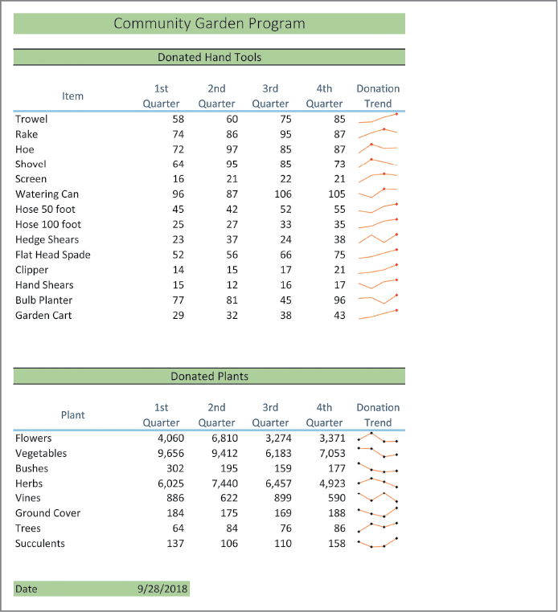
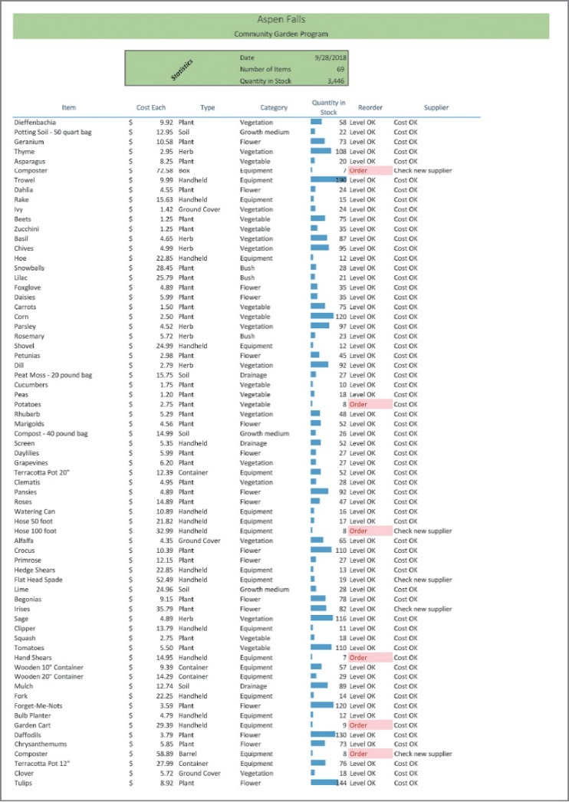

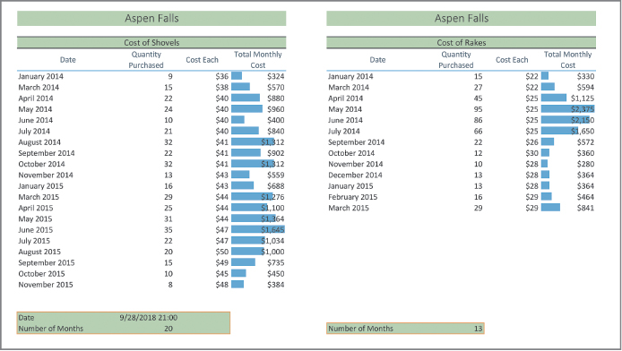
Introduction
Notes:
Once you go through the skills in this chapter, you will be able to create spreadsheets and charts like the ones shown here.

Slide 5
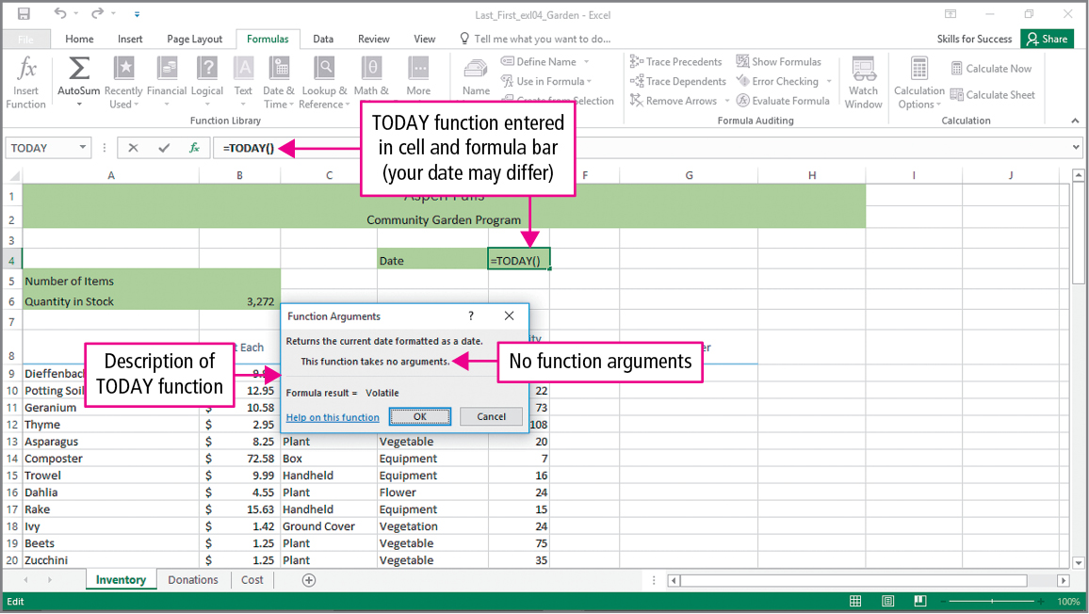
Skill 1: Insert the TODAY, NOW, and COUNT Functions
Notes:
Excel’s TODAY function does not accept an argument. It returns the serial number of the current date. The TODAY function will display the current date each time the workbook is opened. A function that provides a different result each time a workbook is opened is said to be volatile.
Excel’s NOW function returns the serial number of the current date and time. It is a volatile function.

Slide 6
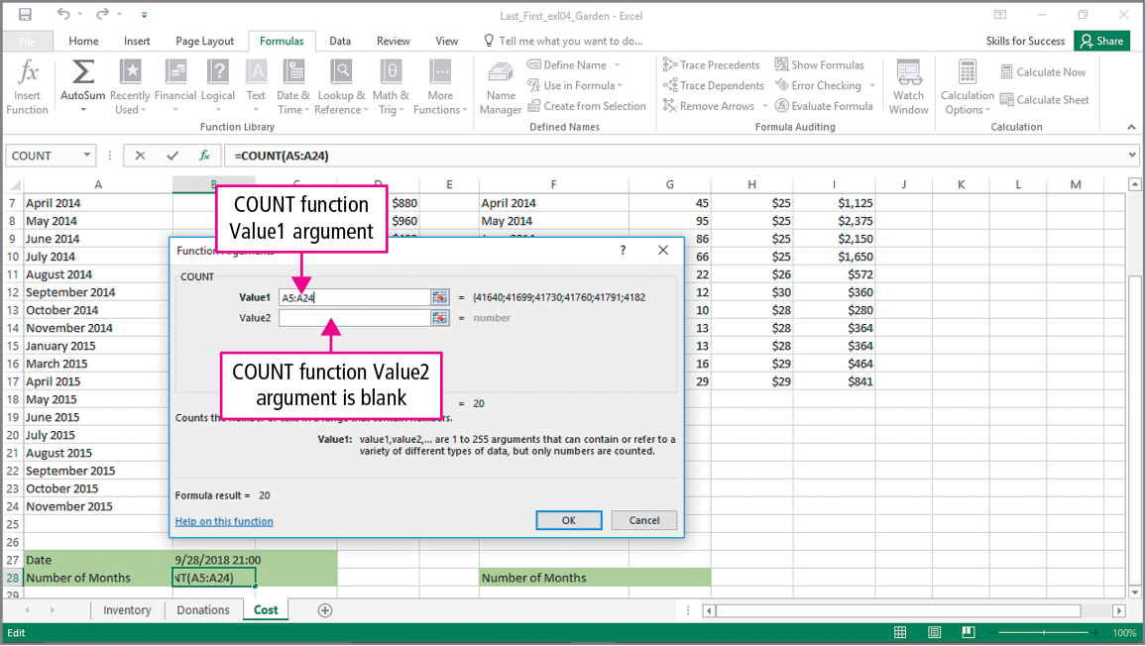
Skill 1: Insert the TODAY, NOW, and COUNT Functions (cont.)
Notes:
The COUNT function counts the number of cells in a range that have numbers in them.

Slide 7
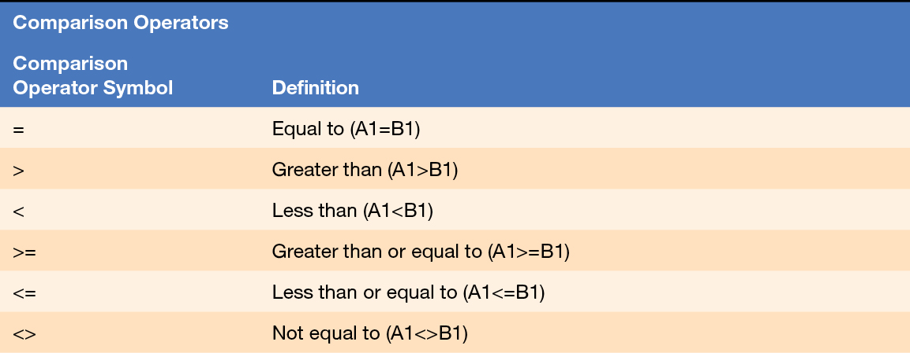
Skill 2: Insert the IF Function
Notes:
The table on this slide shows the comparison operators used by Excel in the IF Function. A comparison operator compares two values and returns either TRUE or FALSE. You can test to see if two values are equal to each other, if the first is greater than the second, if the first is less than the second, if the first is greater than or equal to the second, if the first is less than or equal to the second, or if the two values are not equal to each other.

Slide 8
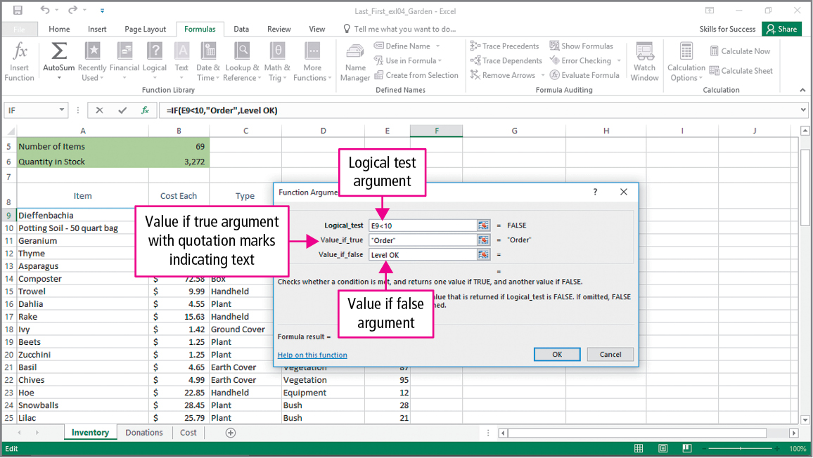
Skill 2: Insert the IF Function (cont.)
Notes:
A logical function applies a logical test to determine whether a specific condition is met. A logical test is any value or expression that can be evaluated as TRUE or FALSE, and Criteria are the conditions specified in the logical test. The IF function is a logical function that checks whether criteria are met and then returns one value when the condition is TRUE and another value when the condition is FALSE.

Slide 9
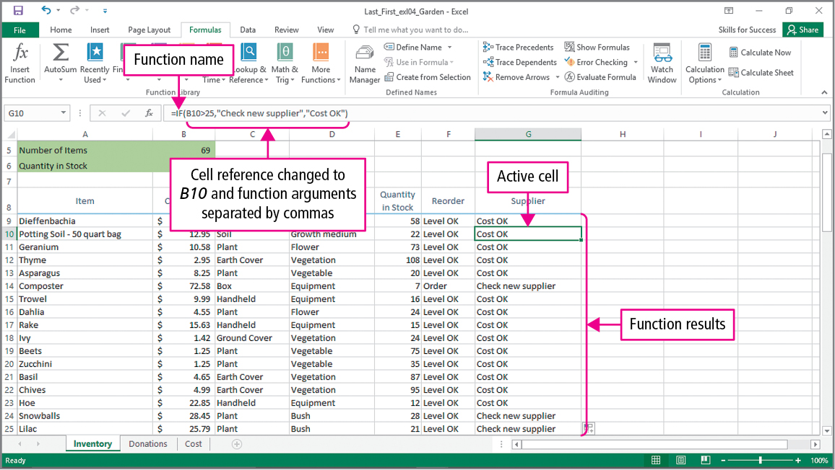
Skill 2: Insert the IF Function (cont.)
Notes:
Notice that column G is made up of calls to the IF function. The value displayed depends upon the value stored in column B. If the value in cell B10 is greater than 25(TRUE), the “Check new supplier” message displays, and if the value is not greater than 25(FALSE), the “Cost OK” message is displayed.

Slide 10
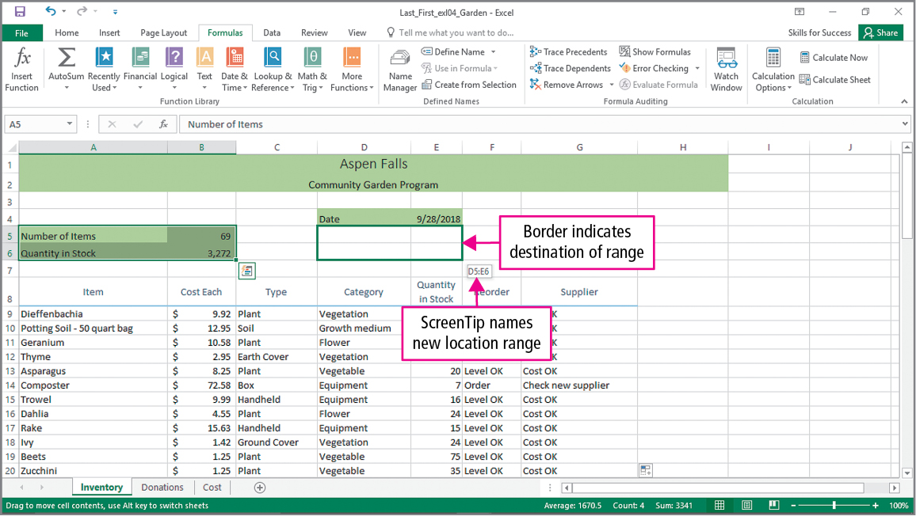
Skill 3: Move Functions, Add Borders, and Rotate Text
Notes:
Cell references in formulas and functions do not change when you move them by dragging them. This slide shows what happens when you drag the range A5:B6 to the range D5:E6.

Slide 11
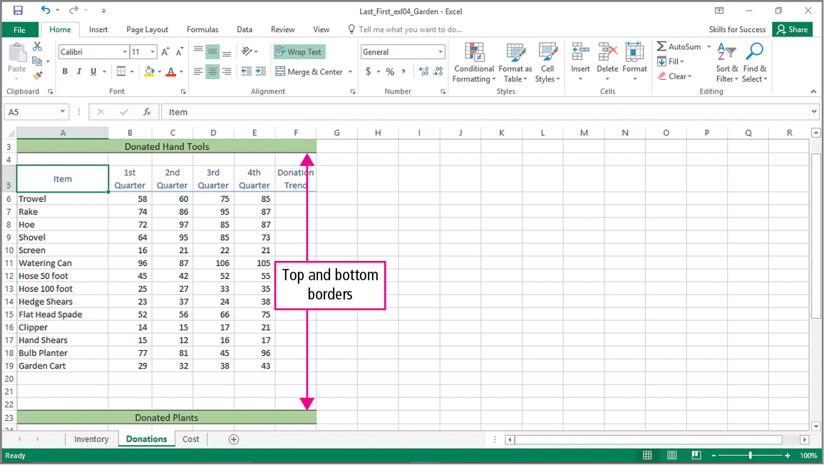
Skill 3: Move Functions, Add Borders, and Rotate Text (cont.)
Notes:
Borders and shading emphasize a cell or a range of cells. Using the Border button allows you to add borders to a range. In this case, top and bottom borders have been added to the merged cells at the top and bottom of the data.

Slide 12
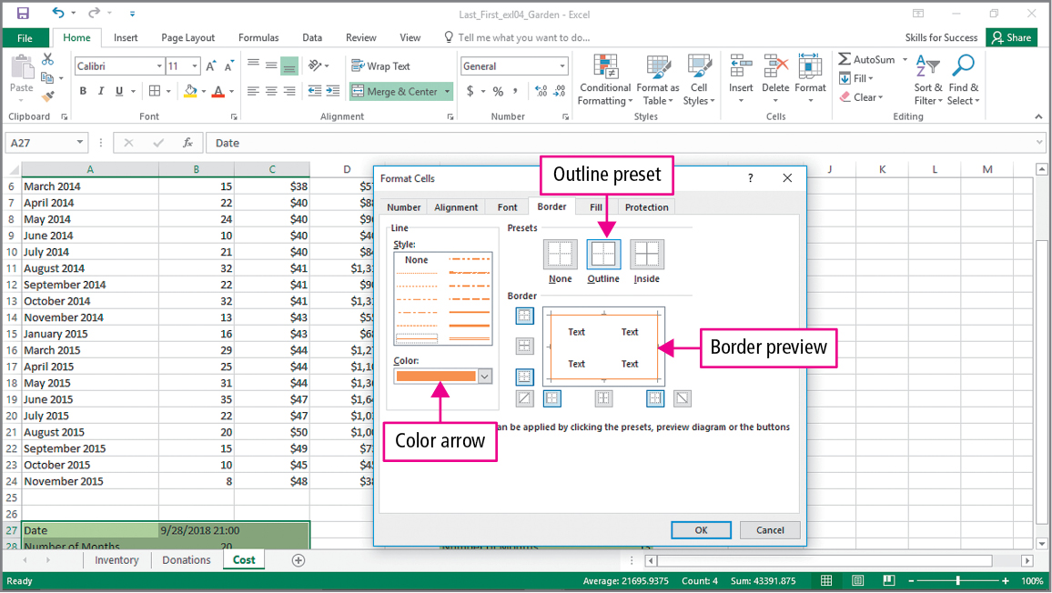
Skill 3: Move Functions, Add Borders, and Rotate Text (cont.)
Notes:
The Format Cells dialog box shown on this slide allows you to change the color of the border, use preset outlines, and preview the borders you have chosen.

Slide 13
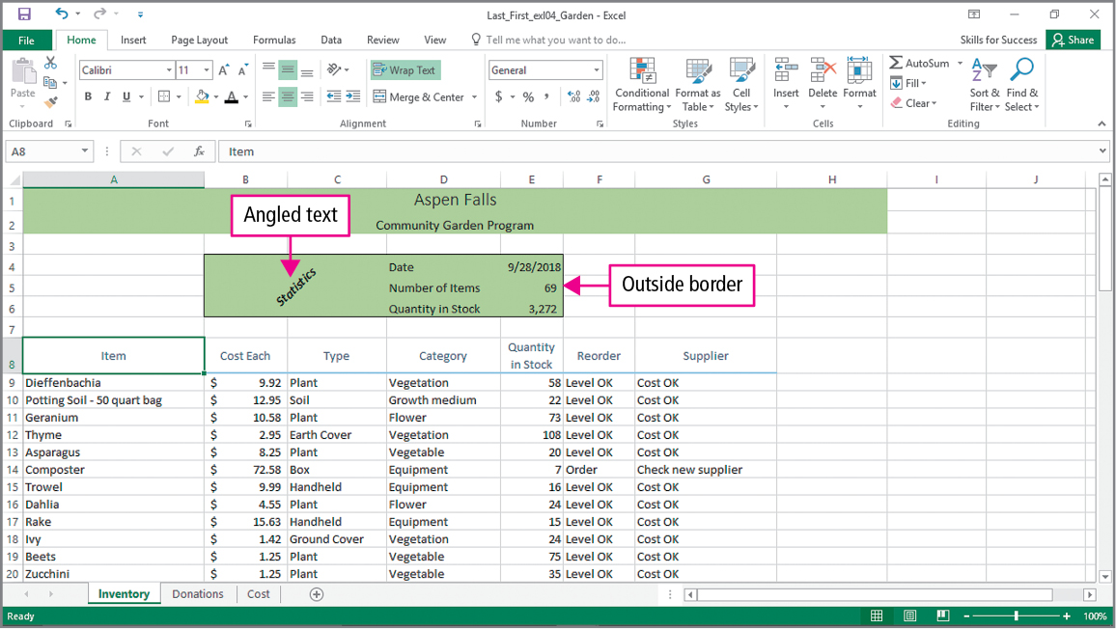
Skill 3: Move Functions, Add Borders, and Rotate Text (cont.)
Notes:
Rotated or angled text draws attention to the text on a worksheet. This slide shows angled text merged across columns B and C.

Slide 14
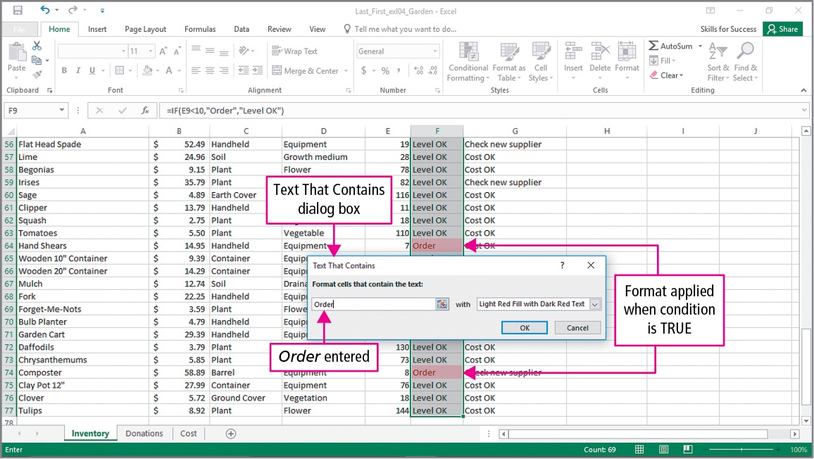
Skill 4: Apply Conditional Formatting
Notes:
Conditional formatting is a format such as cell shading or font color that is applied to cells when a certain condition is true. This makes it easier to analyze data by emphasizing differences in cell values.

Slide 15
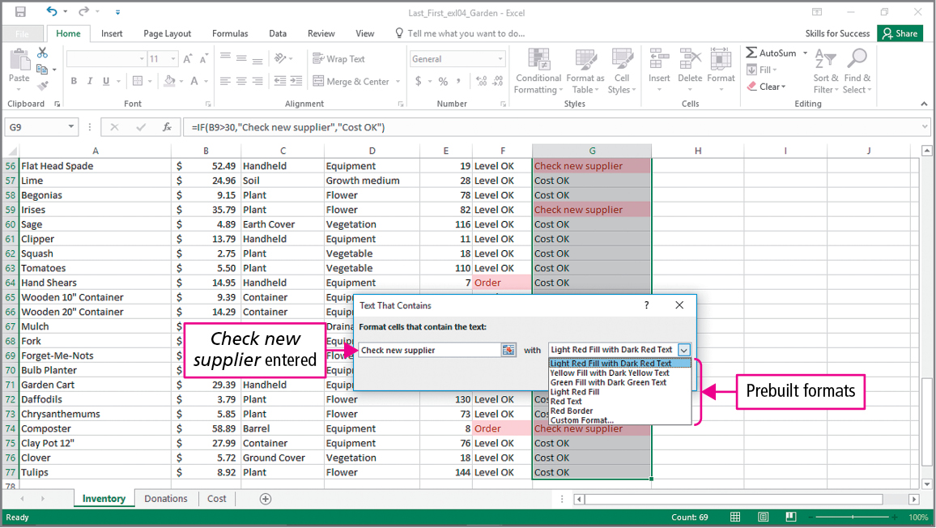
Skill 4: Apply Conditional Formatting (cont.)
Notes:
Excel provides prebuilt Conditional Formatting formats, or you can build our own custom formatting.

Slide 16
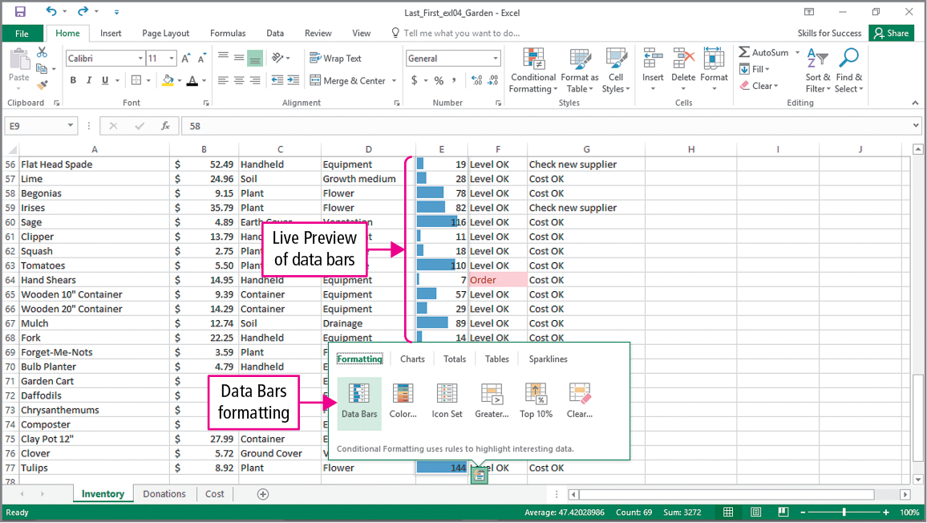
Skill 4: Apply Conditional Formatting (cont.)
Notes:
Data bars provide a visual cue about the data in a cell relative to data in other cells. The Quick Analysis button is one of the options for inserting data bars.

Slide 17
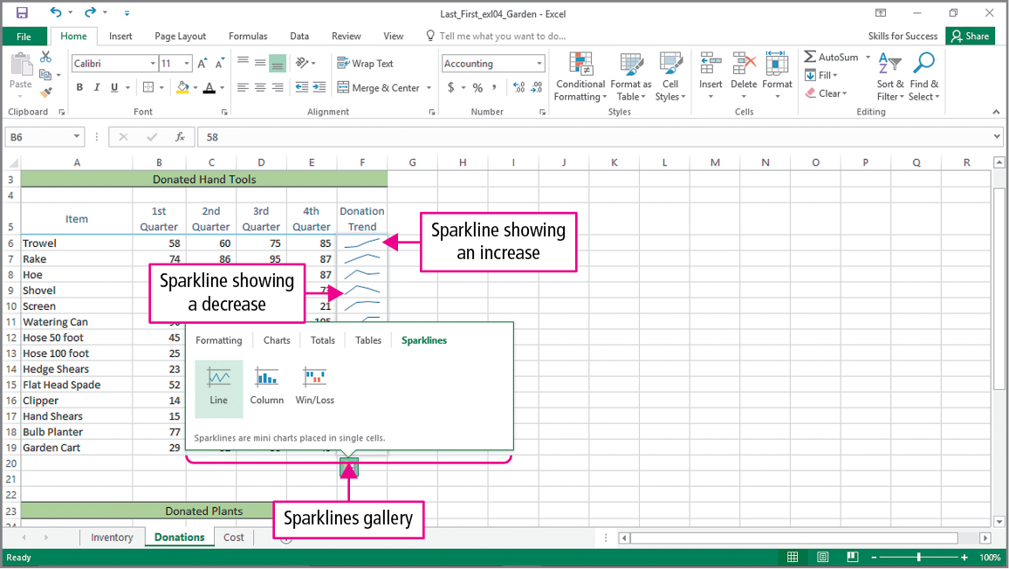
Skill 5: Insert Sparklines
Notes:
Data trends can be shown visually using a chart that is contained in a cell. These charts are known as sparklines. Sparklines can be added by clicking on the Quick Analysis button.

Slide 18
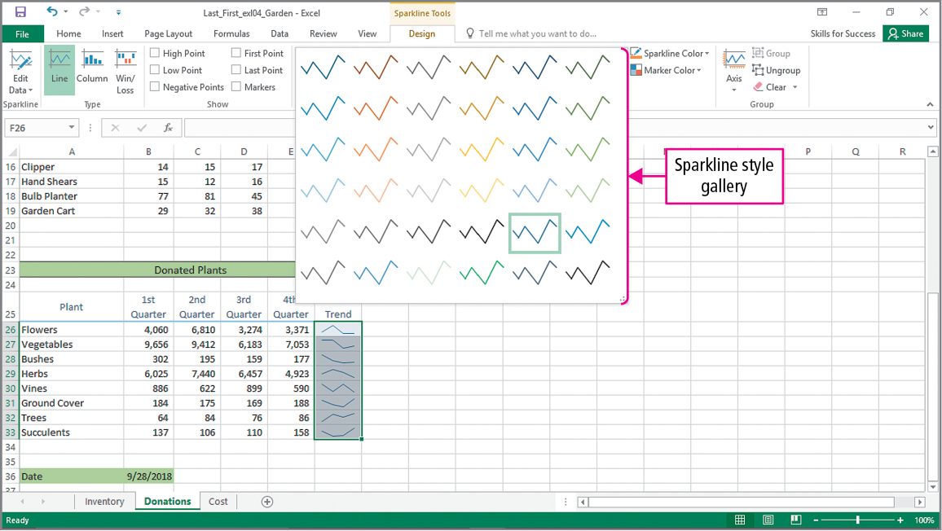
Skill 5: Insert Sparklines (cont.)
Notes:
Using the Sparkline style gallery, you can choose different styles for your sparklines.

Slide 19
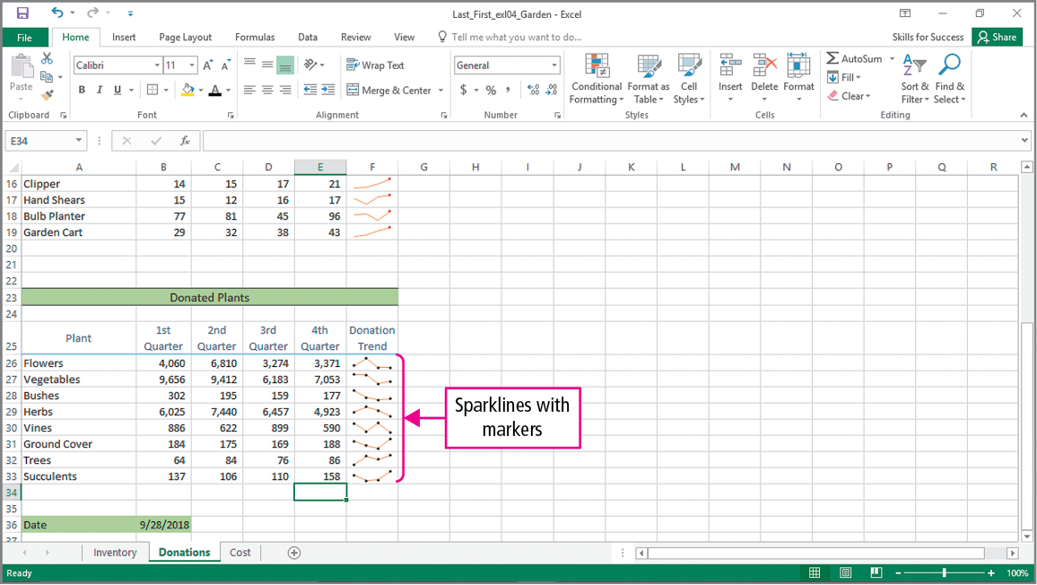
Skill 5: Insert Sparklines (cont.)
Notes:
You also have the option of placing markers on your sparklines to show data points within the sparkline.

Slide 20
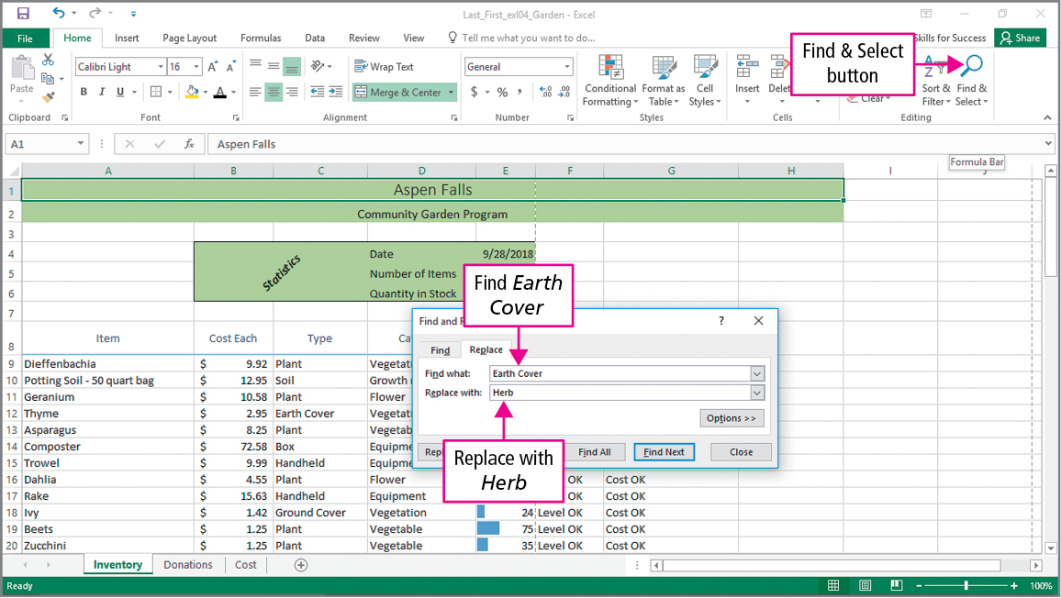
Skill 6: Use Find and Replace
Notes:
Excel’s Replace feature finds a series of characters in a worksheet or range and replaces them with a different set of characters. The Find and Replace dialog box on this slide shows that the phrase “Earth Cover” is to be found and replaced with the phrase “Herb.”

Slide 21
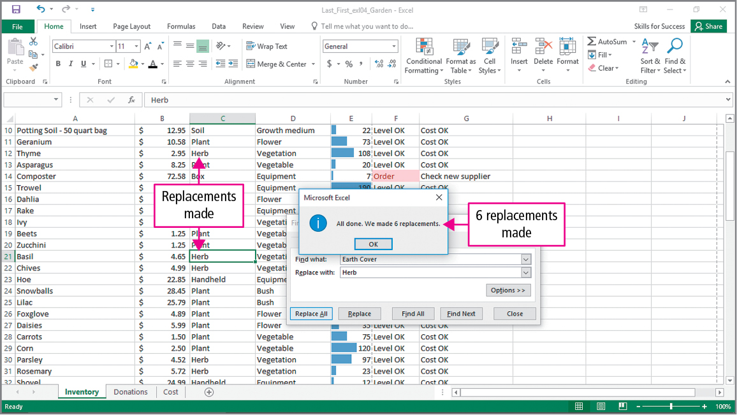
Skill 6: Use Find and Replace (cont.)
Notes:
After selecting Replace All, Excel indicates that six replacements were made.

Slide 22
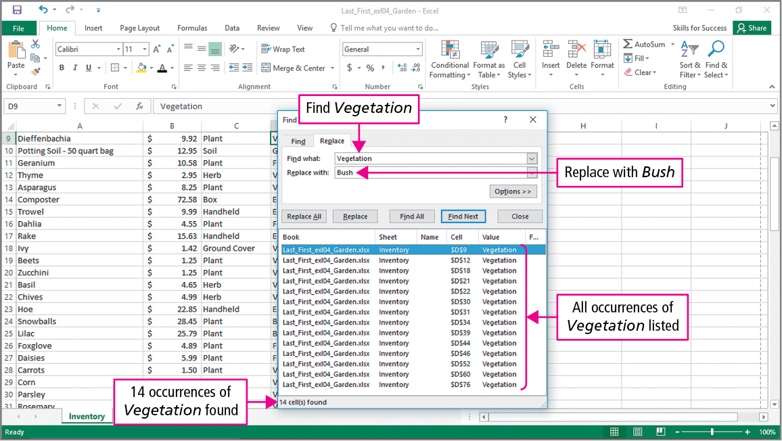
Skill 6: Use Find and Replace (cont.)
Notes:
The Find and Replace dialog box on this slide indicates that the word “Vegetation” should be replaced with the word “Bush”. Once all occurrences are found, the user can choose to replace only certain ones.

Slide 23
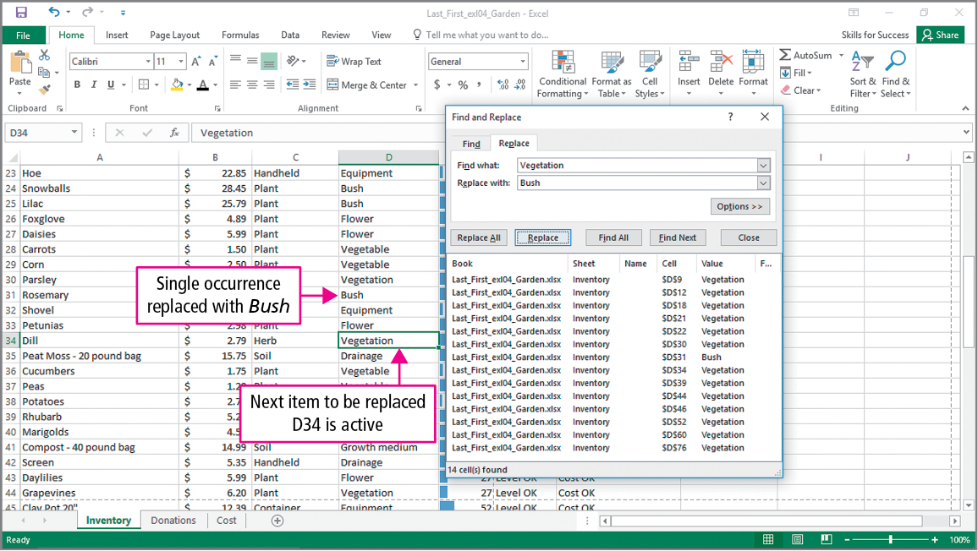
Skill 6: Use Find and Replace (cont.)
Notes:
We see on this slide that only the item found in cell D31 was replaced.

Slide 24
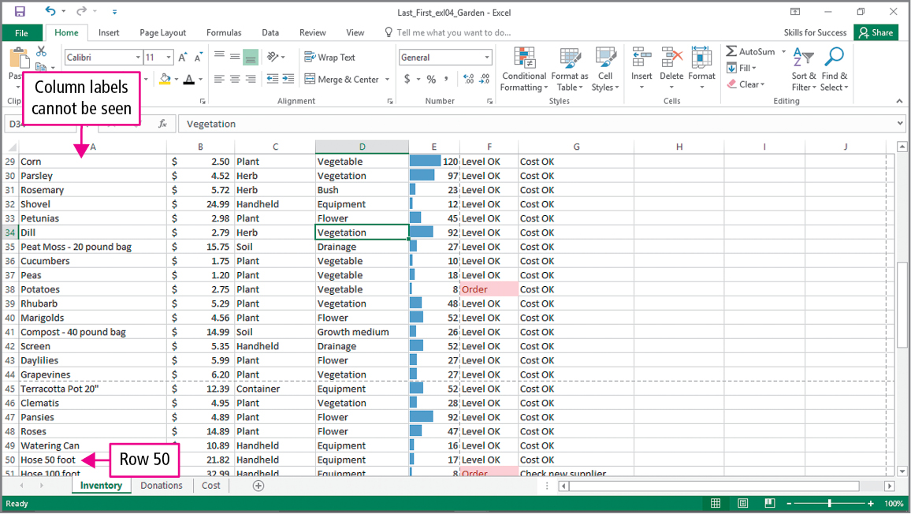
Skill 7: Freeze and Unfreeze Panes
Notes:
Sometimes when you scroll through a workbook, columns and rows that are being used as headings can scroll off of the page, making it difficult to read your data. The Freeze Panes command keeps chosen rows and columns visible regardless of where you scroll through the worksheet. This slide shows that if you scroll down far enough, the column headings are no longer visible.

Slide 25
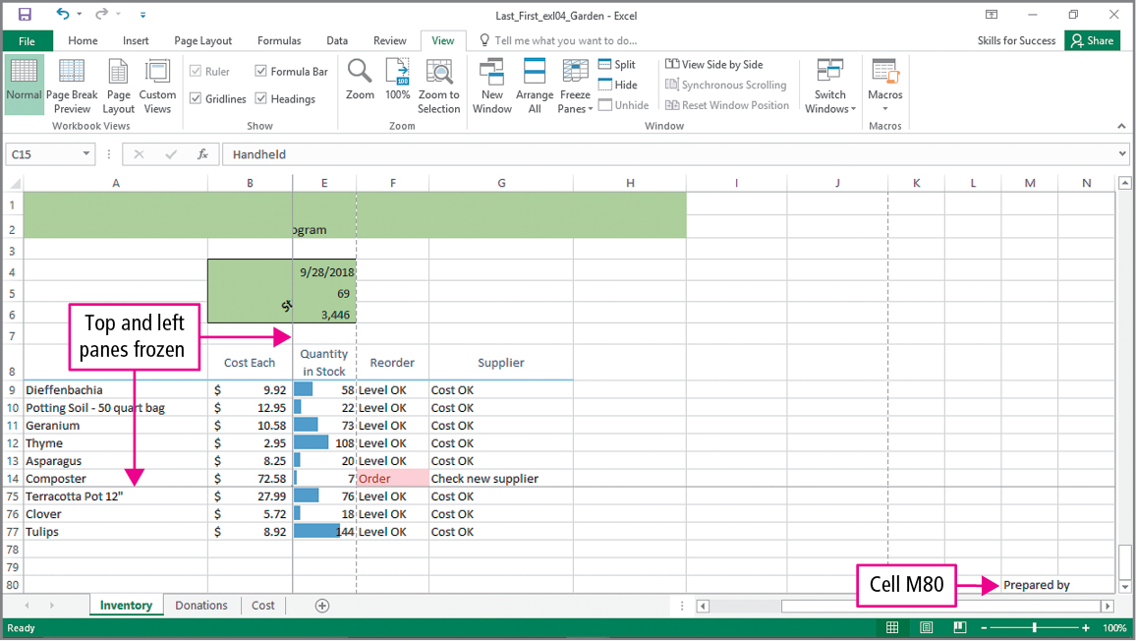
Skill 7: Freeze and Unfreeze Panes (cont.)
Notes:
This slide shows what happens if you scroll through the worksheet after using the Freeze Panes command on rows above 15 and to the left of column C.

Slide 26
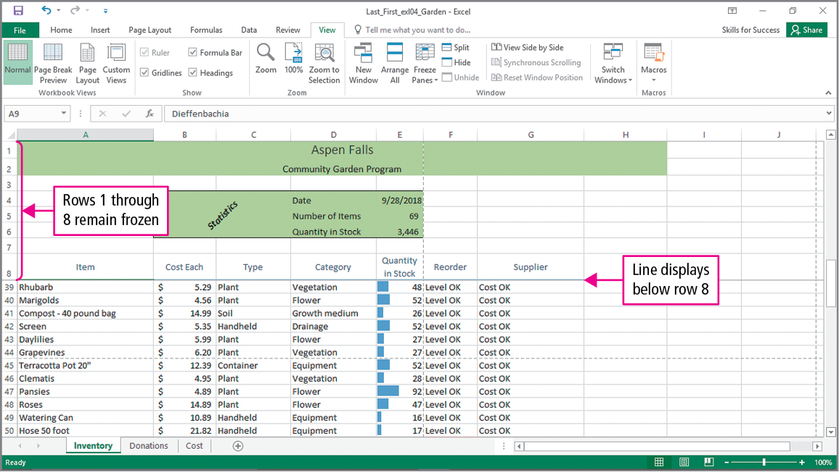
Skill 7: Freeze and Unfreeze Panes (cont.)
Notes:
The Unfreeze Panes command causes the frozen panes to become unfrozen. You can then move your cursor and change the rows and columns that you want frozen.

Slide 27
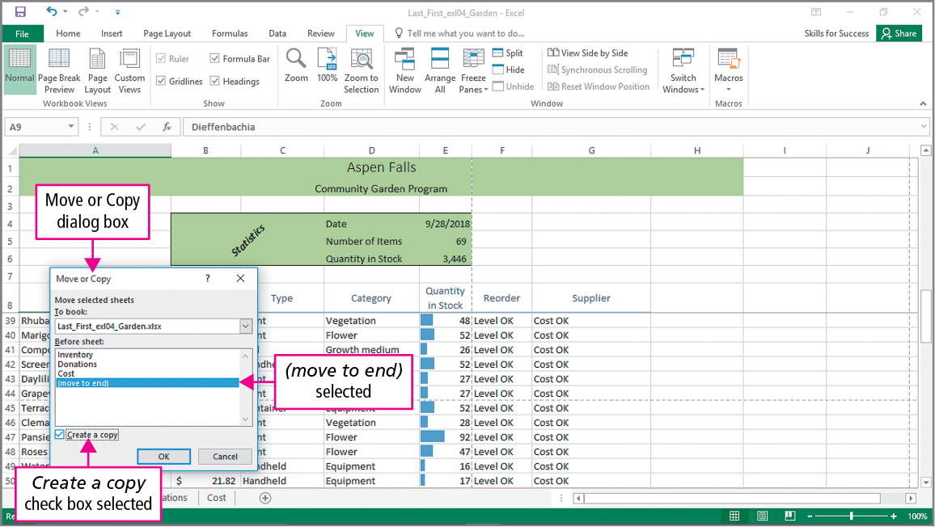
Skill 7: Freeze and Unfreeze Panes (cont.)
Notes:
You can use the Move or Copy dialog box to create a copy of a worksheet.

Slide 28
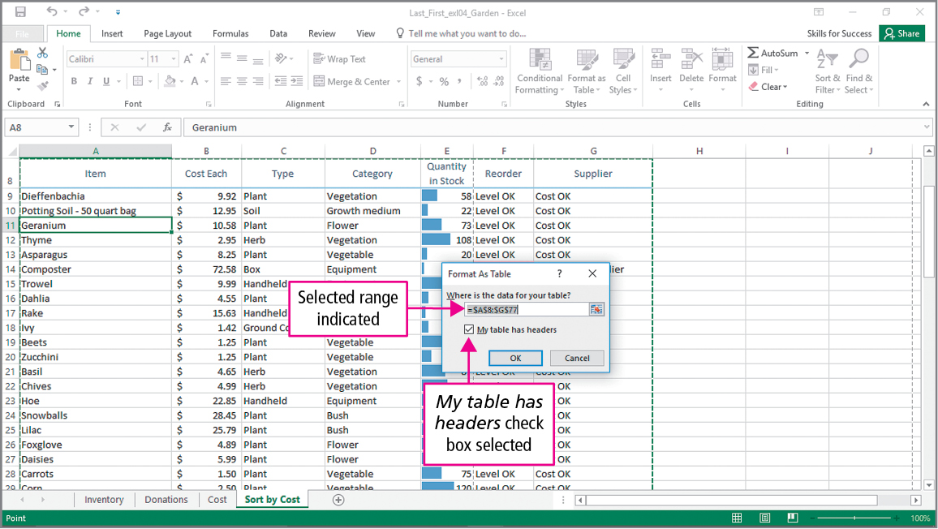
Skill 8: Create and Sort Excel Tables
Notes:
An Excel table is a series of rows and columns that contain related data that have been formatted as a table. The data stored in an Excel table is managed separately from the other data in the workbook.

Slide 29
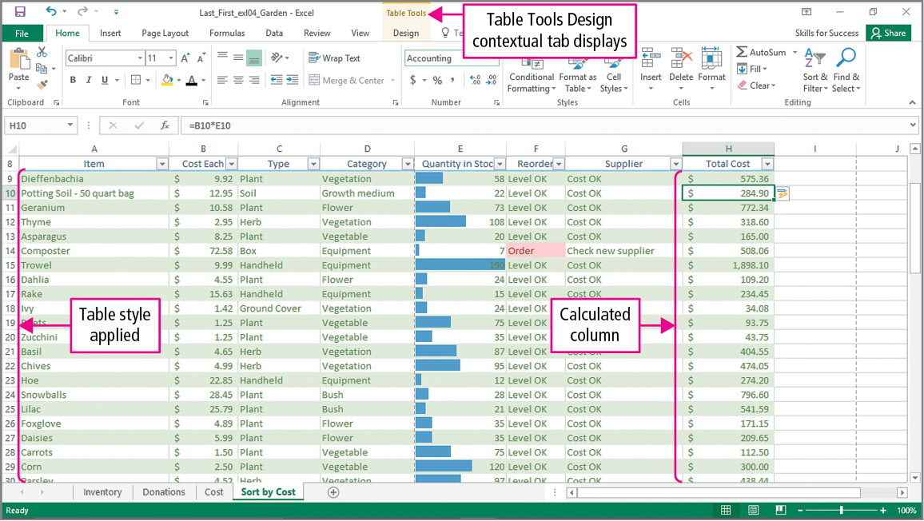
Skill 8: Create and Sort Excel Tables (cont.)
Notes:
Column H is an example of a calculated column. An Excel table creates a calculated column that uses a single formula that adjusts for each row.

Slide 30
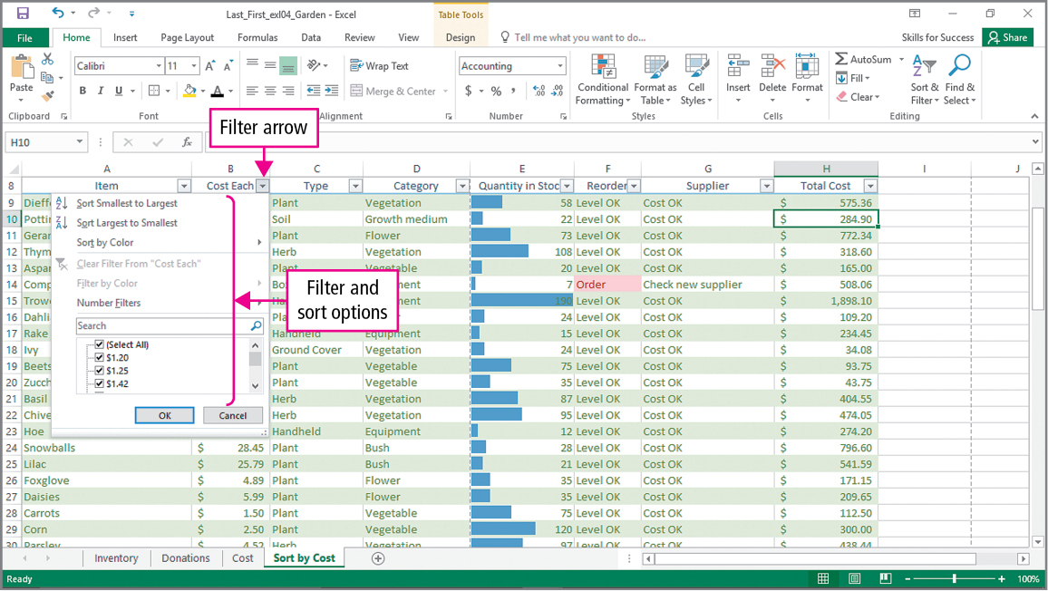
Skill 8: Create and Sort Excel Tables (cont.)
Notes:
Using the filter arrow within a table allows you to sort the table either from smallest to largest or from largest to smallest.

Slide 31
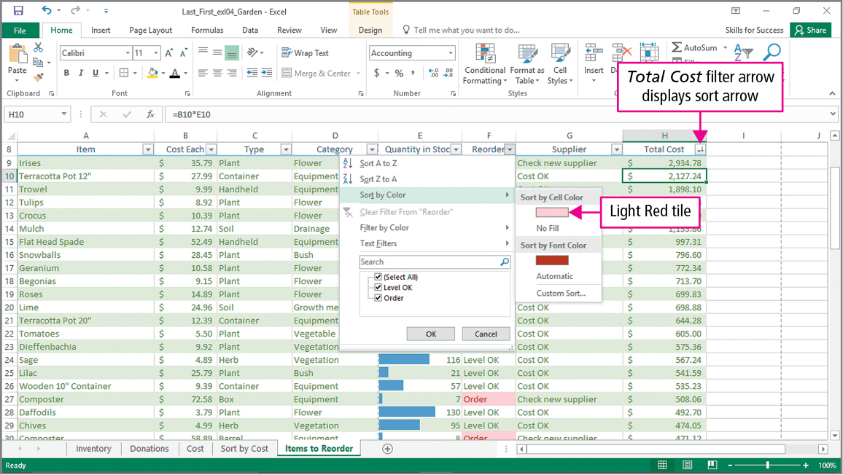
Skill 8: Create and Sort Excel Tables (cont.)
Notes:
If you have applied conditional formatting, you can also sort by the colors used in that formatting.

Slide 32
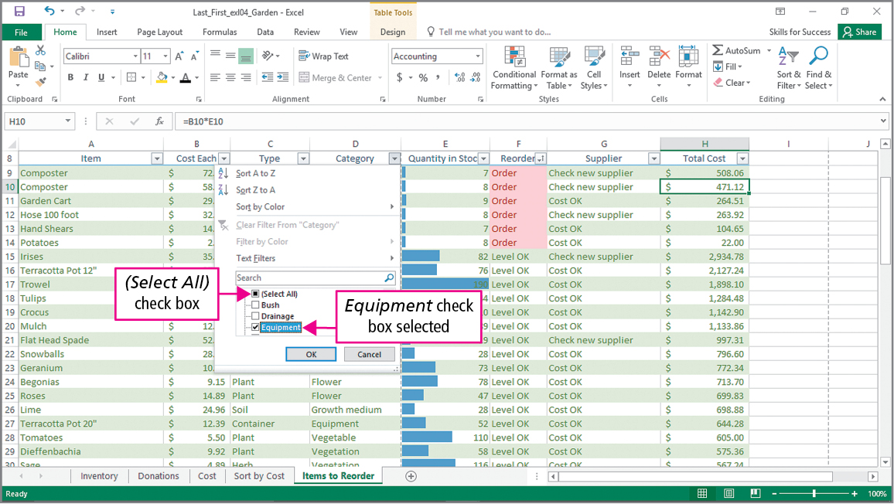
Skill 9: Filter Excel Tables
Notes:
Data in an Excel worksheet can be filtered. When you filter data, rows that do not meet the criteria are temporarily hidden.

Slide 33
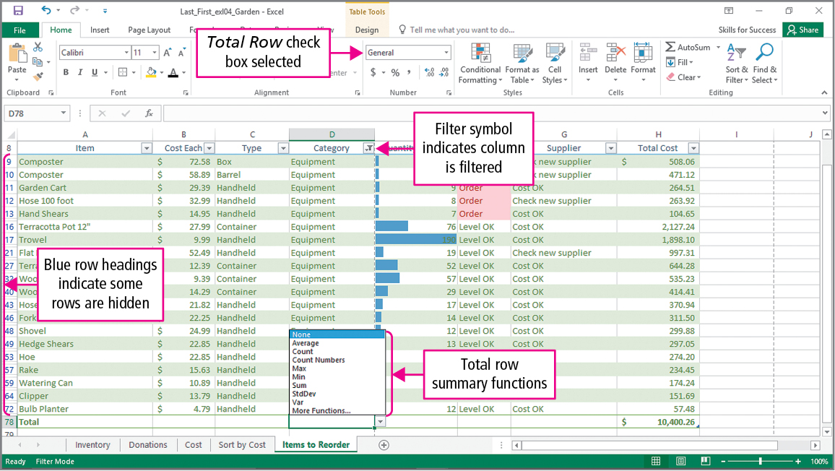
Skill 9: Filter Excel Tables (cont.)
Notes:
When filtering data, the Total row displays to provide summary functions in drop-down lists for each column in the Excel table.

Slide 34
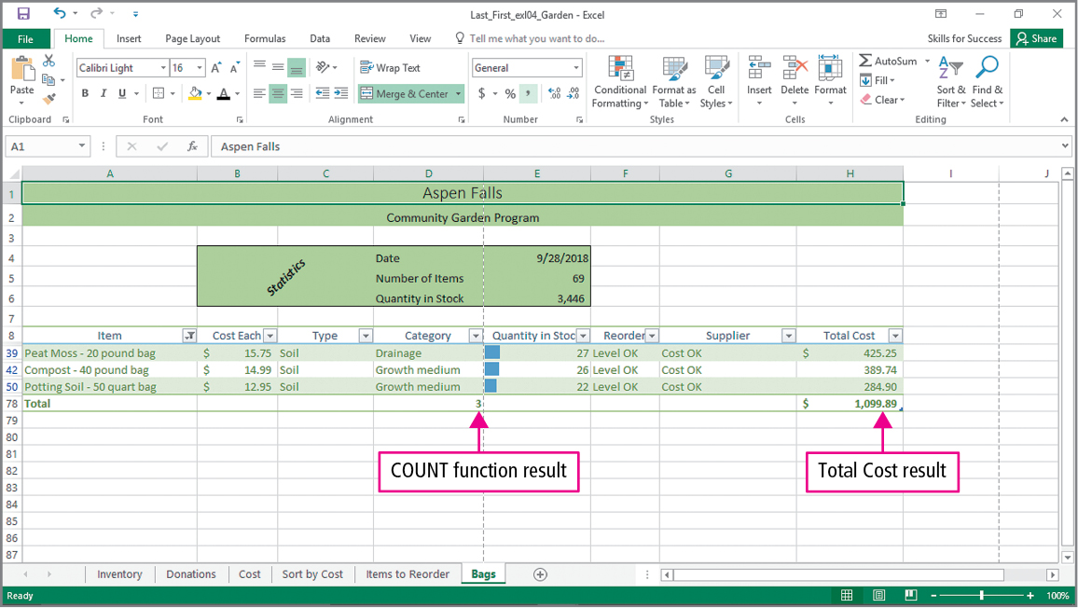
Skill 9: Filter Data (cont.)
Notes:
The COUNT function is showing how many matches for bag were found in the data.

Slide 35
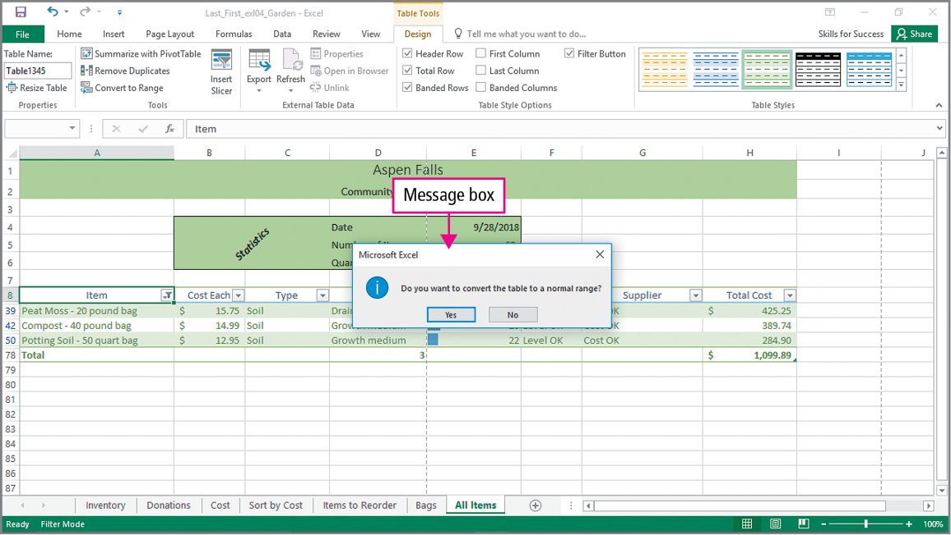
Skill 10: Convert Tables to Ranges and Adjust Worksheet Print Settings
Notes:
An Excel table can be converted into a range retaining the table format applied. On this slide, the message box is asking if you want to convert the table to a normal range. If you do, all filters are removed and you will no longer see the headings. Any existing sorts and formatting will remain.

Slide 36
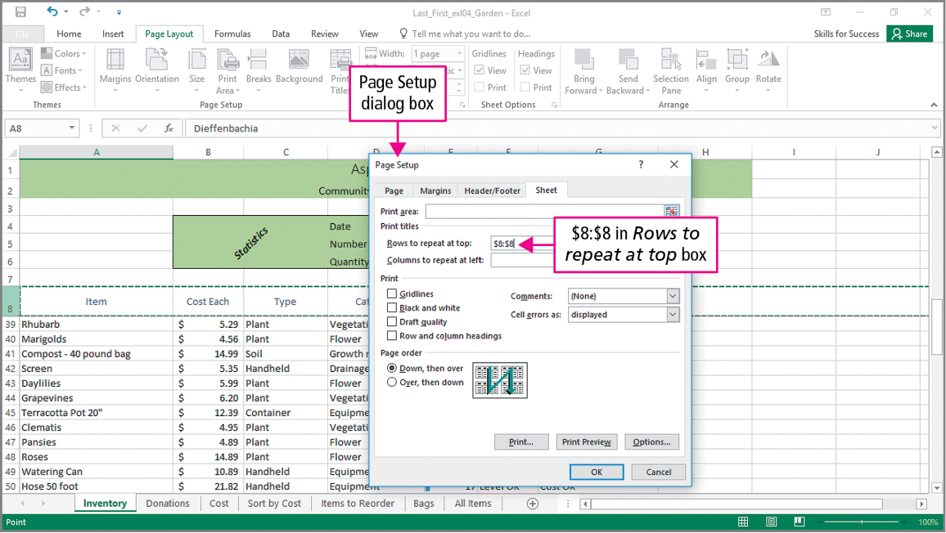
Skill 10: Convert Tables to Ranges and Adjust Worksheet Print Settings (cont.)
Notes:
The Page Setup dialog box allows you to choose rows of the workbook that you want to be printed on each page when we print the workbook.

Slide 37
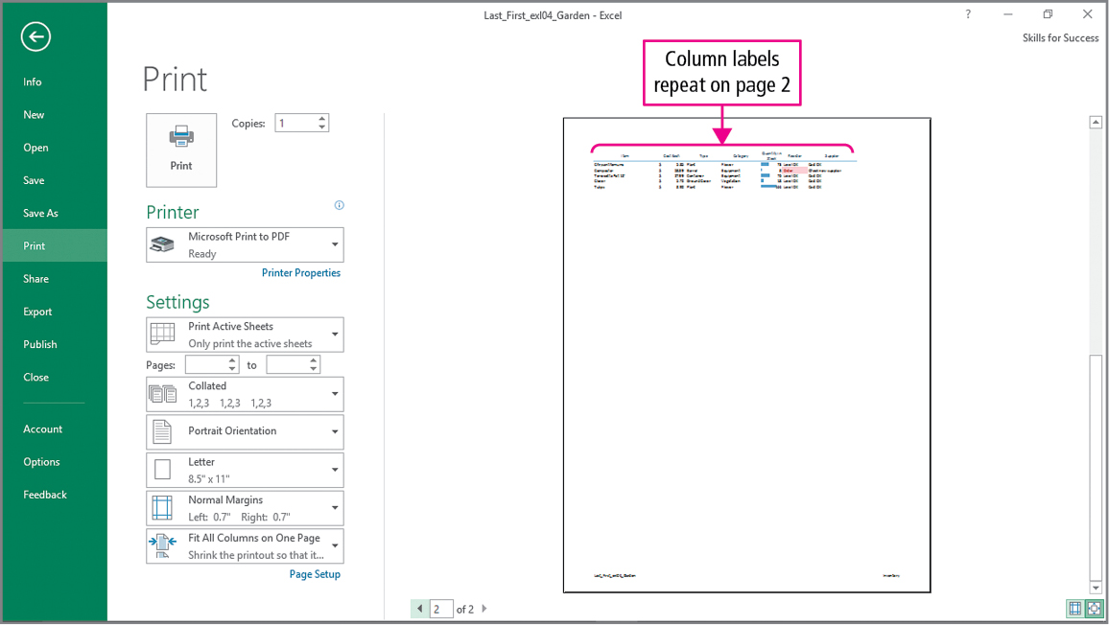
Skill 10: Convert Tables to Ranges and Adjust Worksheet Print Settings (cont.)
Notes:
The Print Preview shows you that the column labels are repeated on page 2.

Slide 38
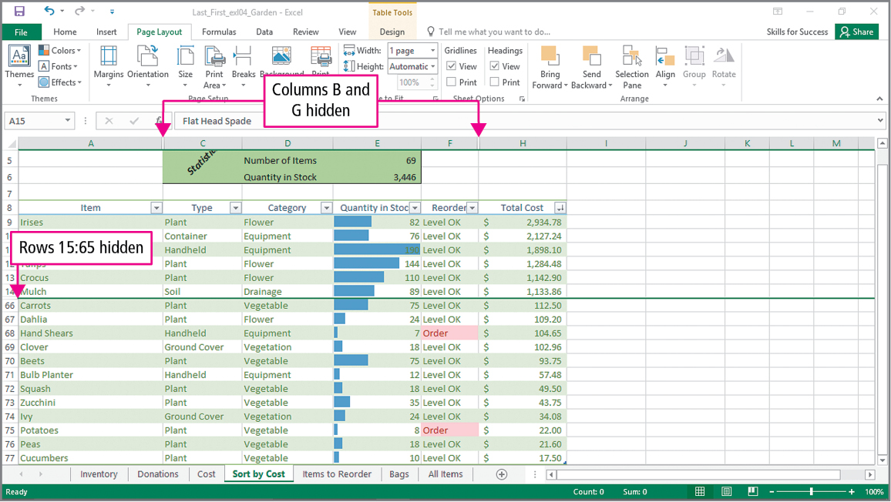
Skill 10: Convert Tables to Ranges and Adjust Worksheet Print Settings (cont.)
Notes:
Sometimes, you may not want to see certain rows or columns of data. You can hide columns or rows. The slide shows that columns B and G are hidden, as are rows 15 to 65. To cause the hidden rows and columns to display, you must unhide them.

Slide 39
More Skills For Success
You will now practice the following additional skills:
Add and Remove Table Columns and Rows
Insert the Payment (PMT) Function
Customize Workbook Views
Use Text and Lookup Functions
Notes:
The More Skills for Success in this chapter will show you how to:
Add and Remove Table Columns and Rows
Insert the Payment (PMT) Function
Customize Workbook Views
Use Text and Lookup Functions

Slide 40
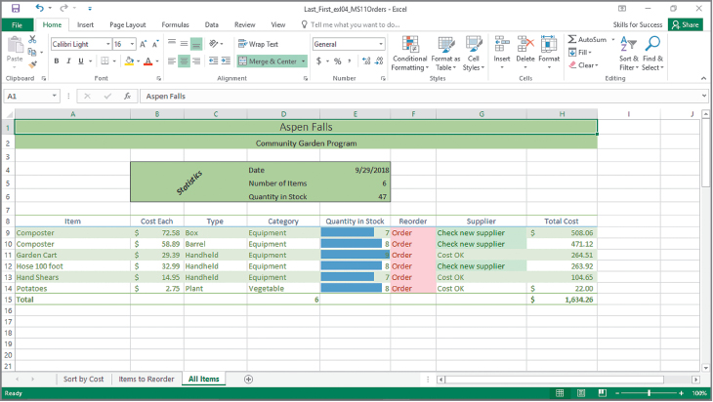
More Skills 11: Add and Remove Table Columns and Rows
Notes:
Various methods can be used to add and remove columns and rows in tables. Rows and columns can be added and deleted by using the Insert or Delete arrows on the Home tab in the Cells group. You can also use the shortcut menu when right-clicking on a row or column.

Slide 41
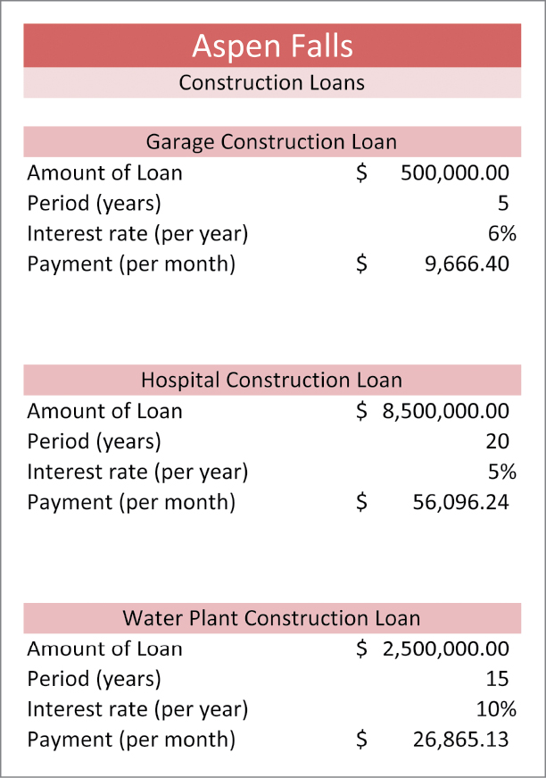
More Skills 12: Insert the Payment (PMT) Function
Notes:
The PMT function calculates the periodic payment on a loan. The interest rate is the charge you pay for borrowing money. The rate is the percentage that is paid for the use of the borrowed money. The principal or Present value (Pv) is the initial amount of the loan. The value at the end of time periods is called Future value (Fv). The Nper is the total number of payments for the loan. The Function Arguments dialog box allows the user to enter the arguments for the PMT function.

Slide 42
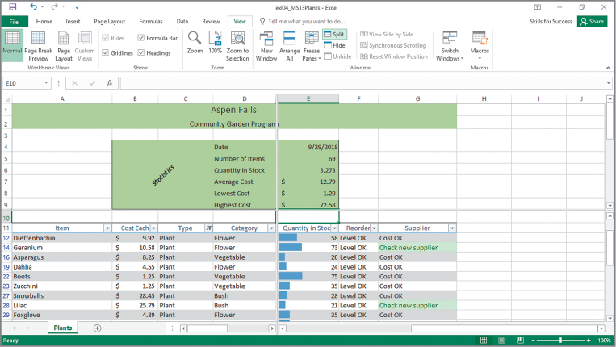
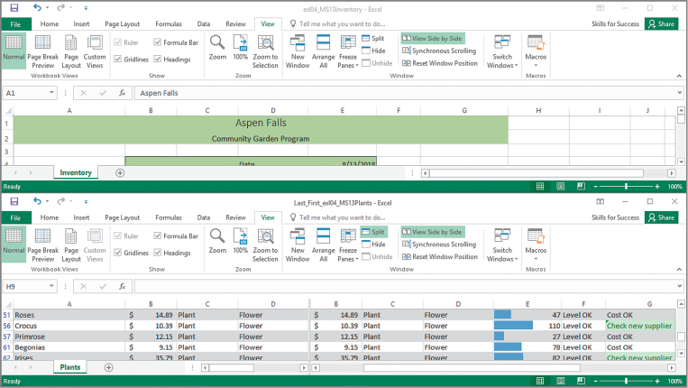
More Skills 13: Customize Workbook Views
Notes:
The split window is a command that divides the window into separate panes so that each pane can be scrolled separately.

Slide 43
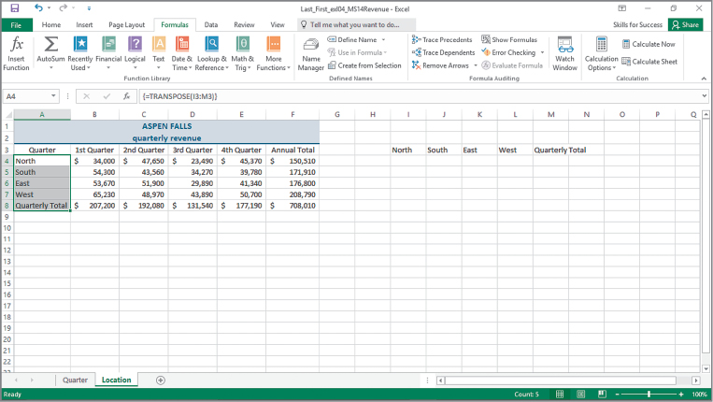
More Skills 14: Use Text and Lookup Functions
Notes:
The LOWER function is a text function that is used to convert a text string to all lower case letters. The UPPER function is a text function used to convert a text string to all uppercase letters. The TRANSPOSE function is a lookup function used to convert a vertical range of cells to a horizontal range, or vice versa.

Slide 44
Summary
In this chapter you have learned to:
Insert the TODAY, NOW, and COUNT Functions
Insert the IF Function
Apply Conditional Formatting and Sparklines
Use Excel Tables
Notes:
In this chapter you have learned how to:
Insert the TODAY, NOW, and COUNT Functions
Insert the IF Function
Move Functions, Add Borders, and Rotate Text
Apply Conditional Formatting
Insert Sparklines
Use Find and Replace
Freeze and Unfreeze Panes
Create, Sort, and Filter Excel Tables
Filter Data
Convert Tables to Ranges, Hide Rows and Columns, and Format Large Worksheets

Slide 45
Questions
Notes:
As you complete this introduction to Excel, be sure you ask questions. You want to understand the concepts so that you can continue to build on them in future chapters.

Slide 46

Copyright
All rights reserved. No part of this publication may be reproduced, stored in a retrieval system, or transmitted, in any form or by any means, electronic, mechanical, photocopying, recording, or otherwise, without the prior written permission of the publisher. Printed in the United States of America.

